Slide 1

Quiz
Management
System

Slide 2
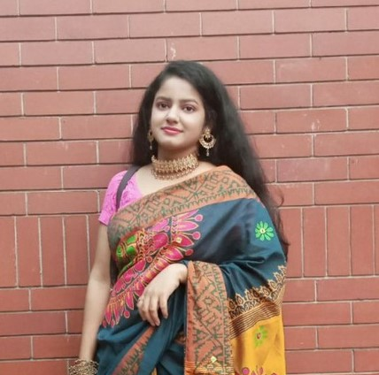
Presented To
Dristi Saha
Lecturer
Daffodil International University
OUR TEAM
Faysal Ahmed
Shakibur Rahman
Esrat Jahan
Fatema Akter
ID: 221-15-4699
ID: 221-15-4714
ID: 221-15-4690
ID: 221-15-4765

Slide 3
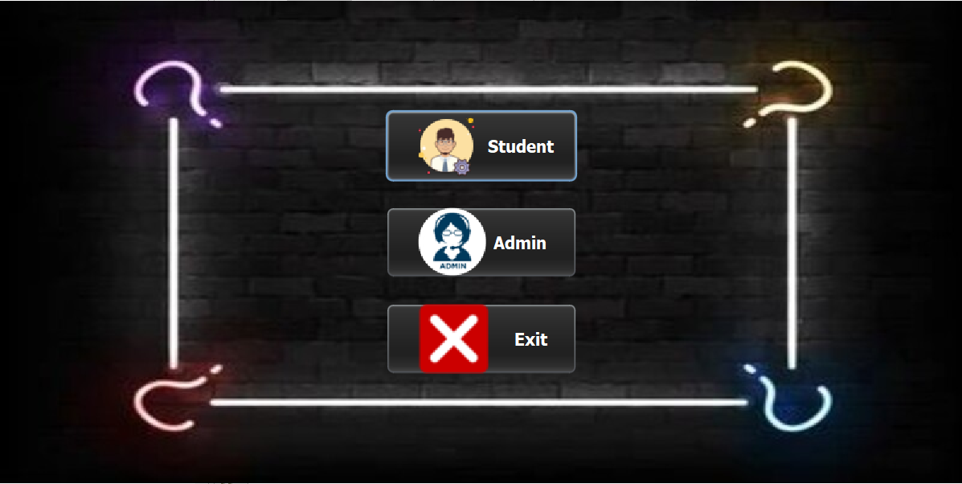
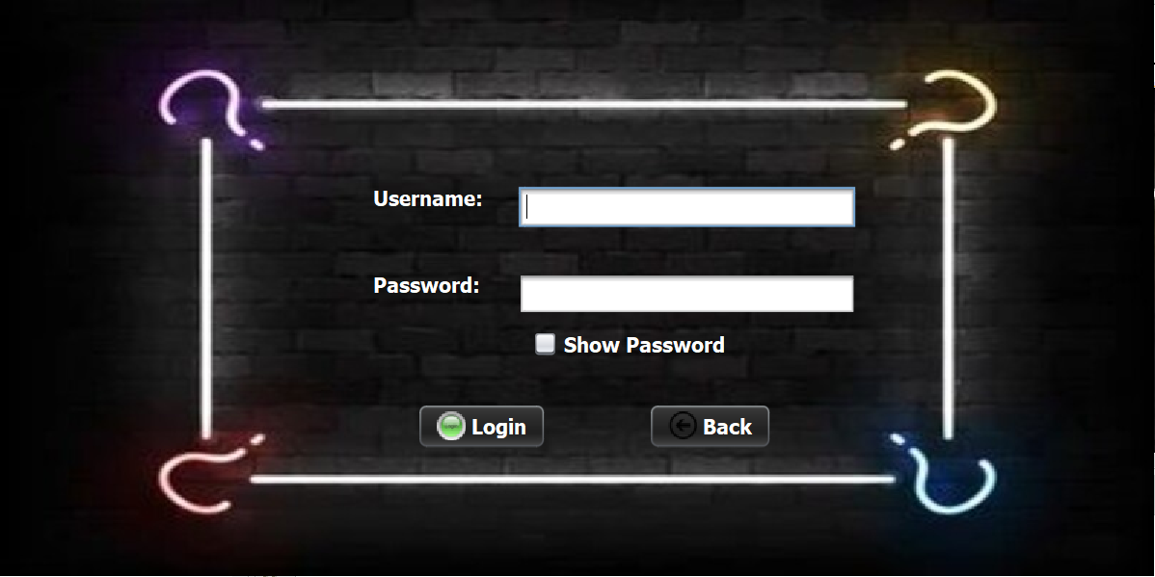
Teacher Login
Home Page

Slide 4
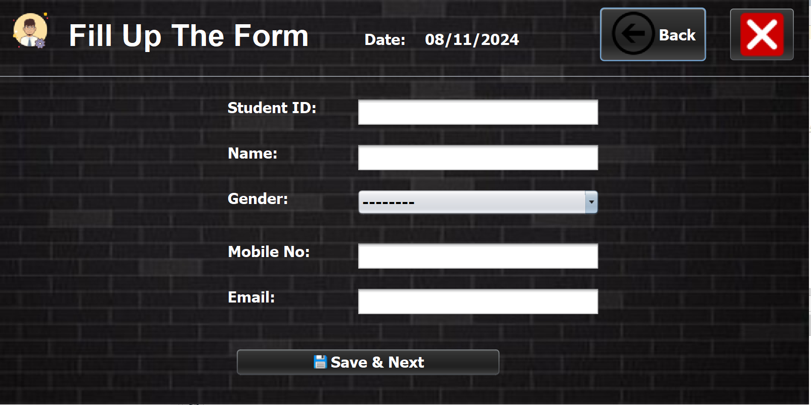
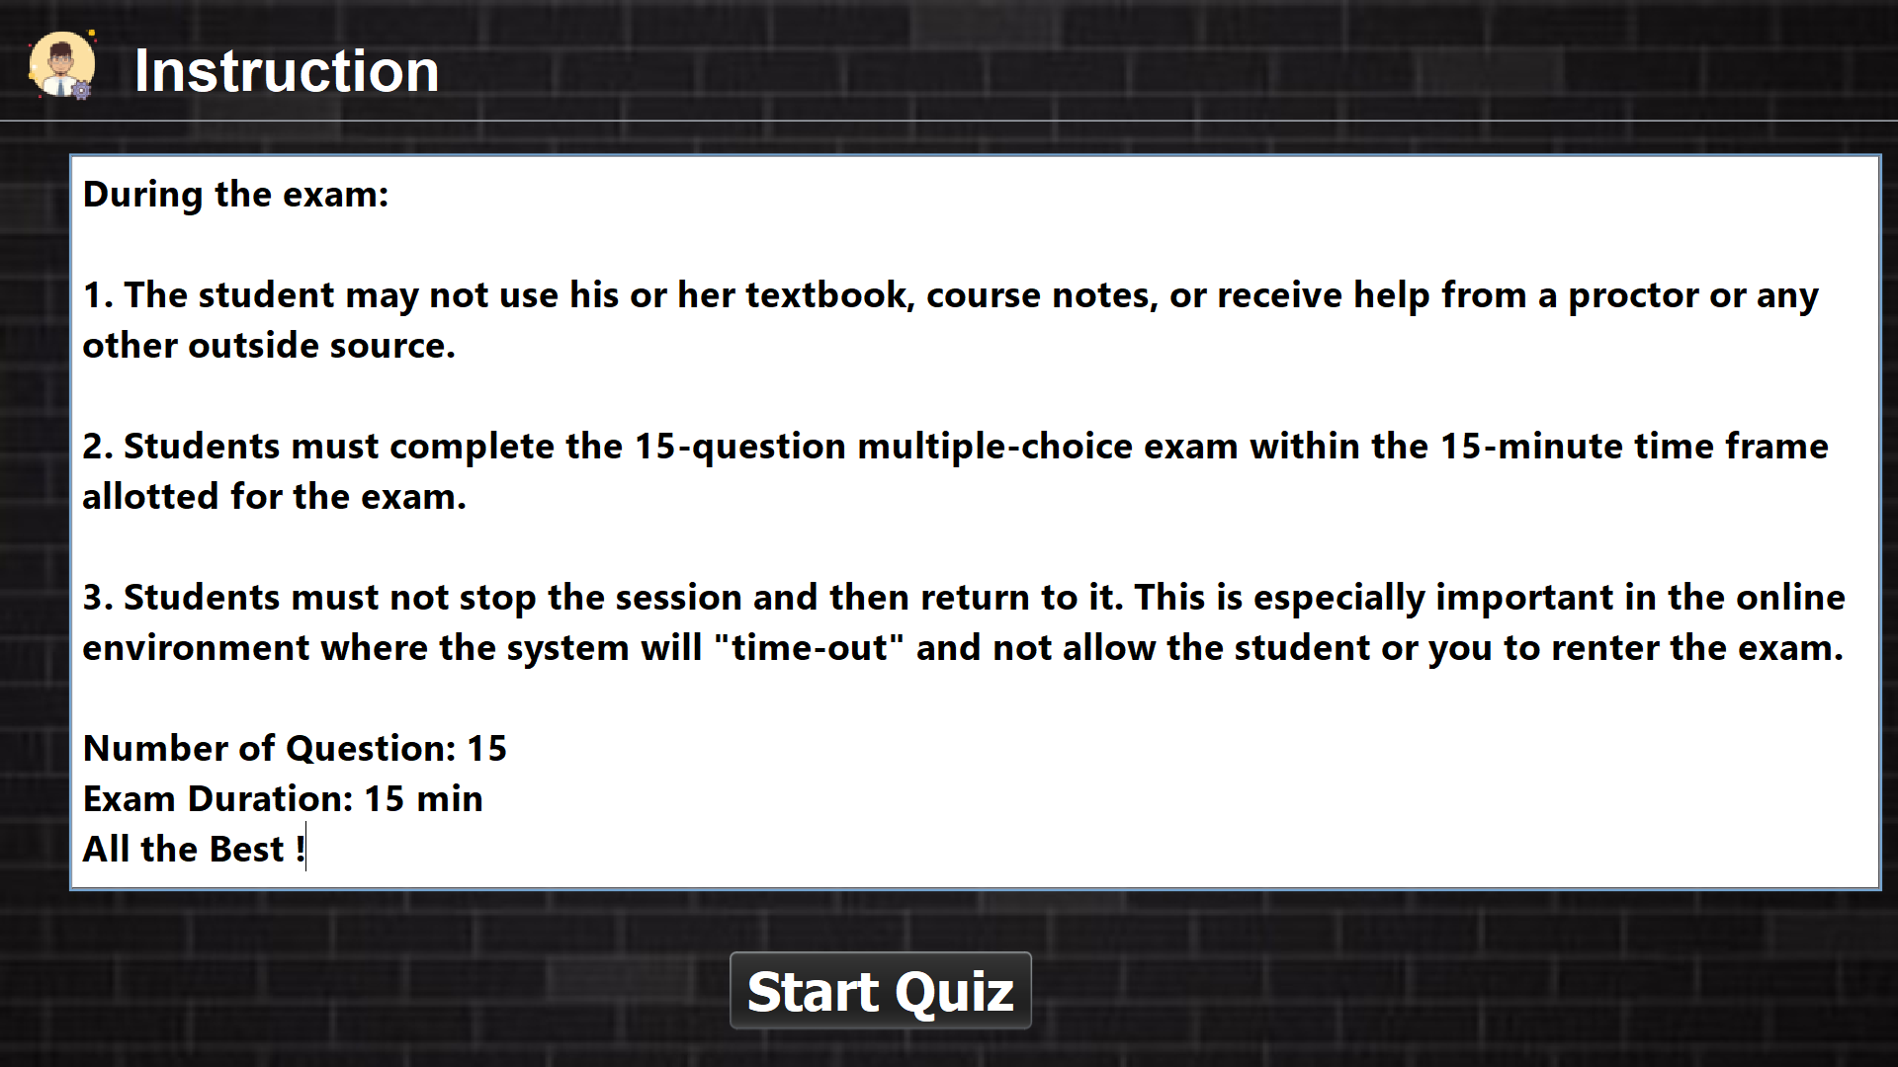
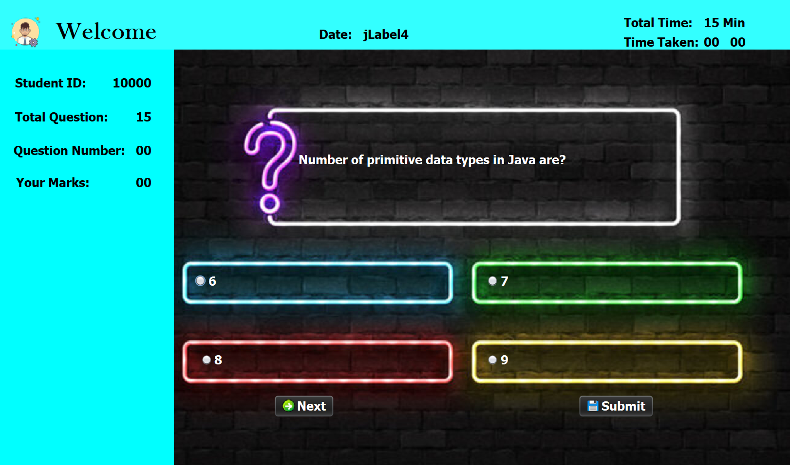
Student Portal

Slide 5
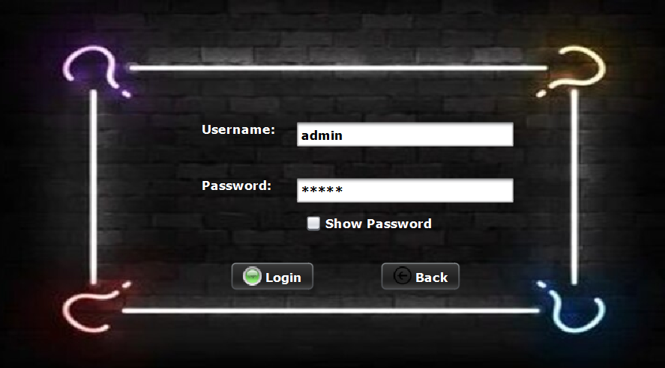
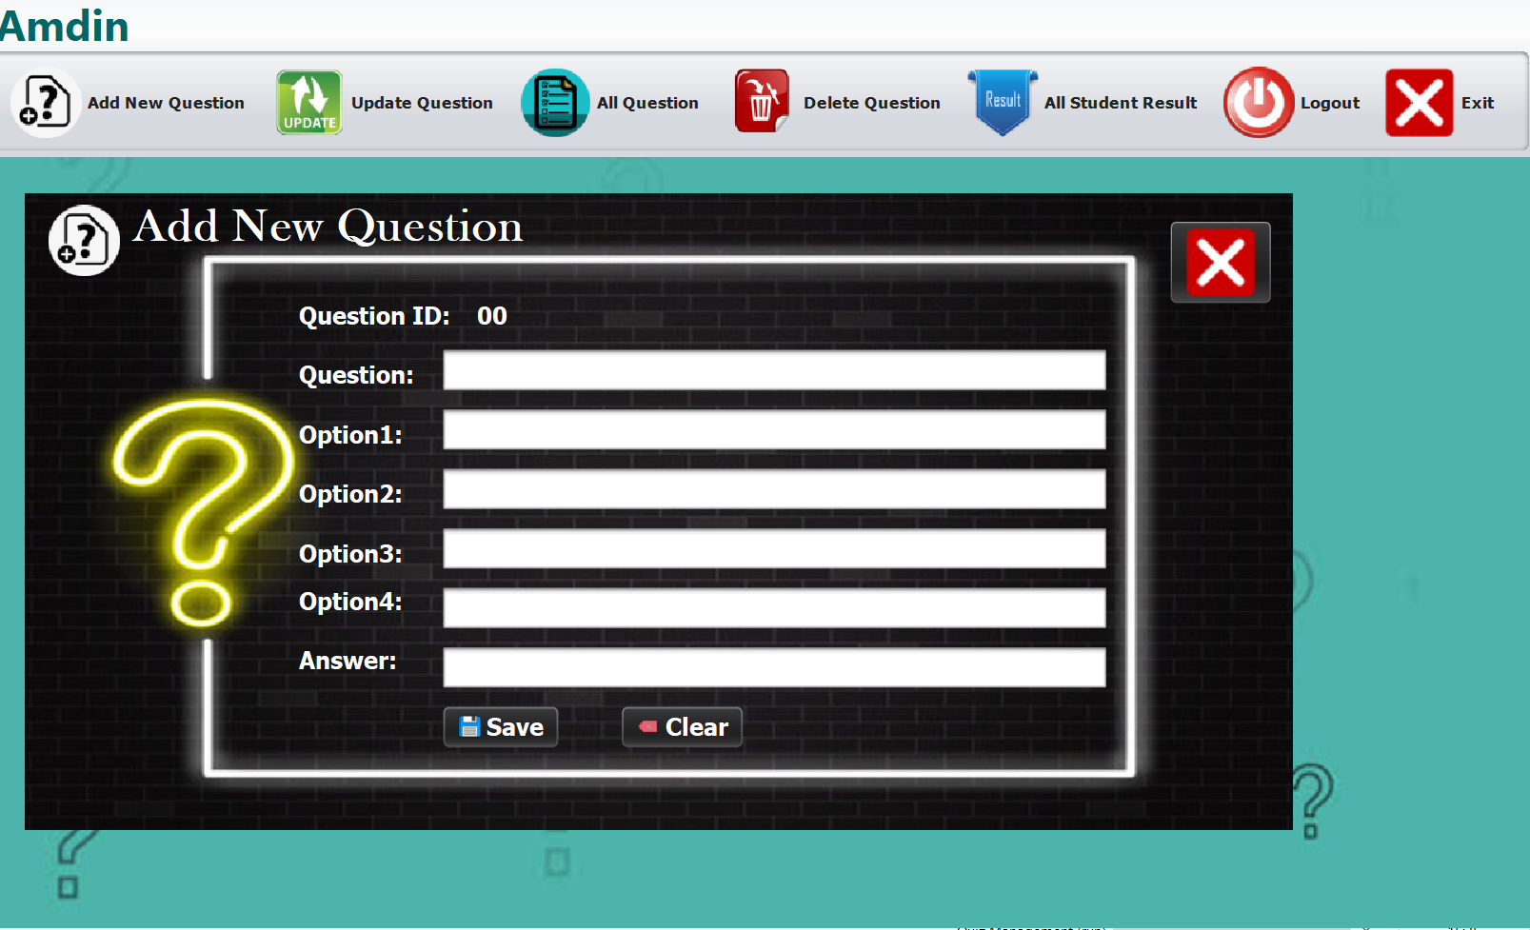
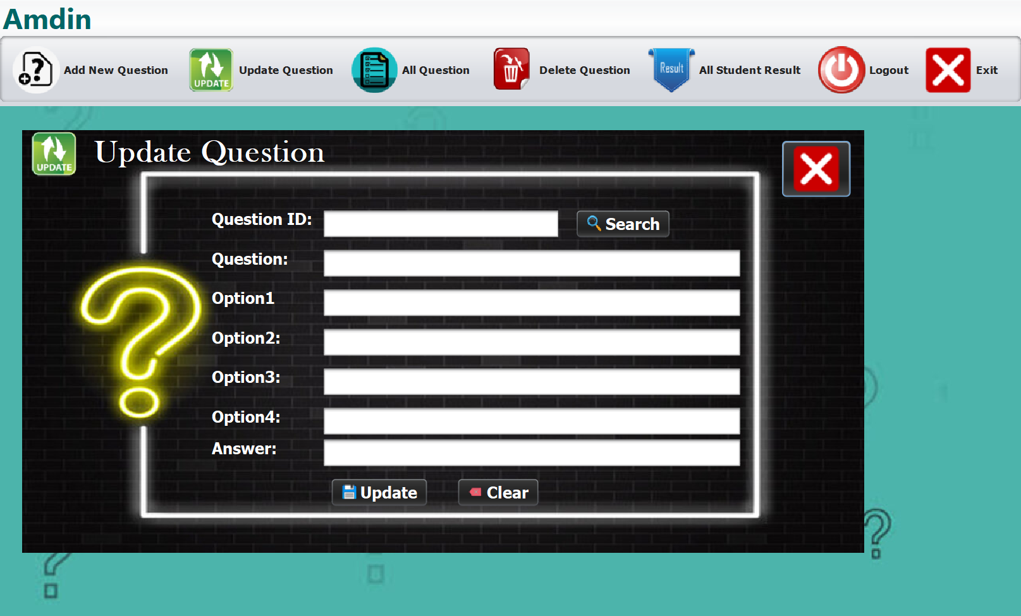
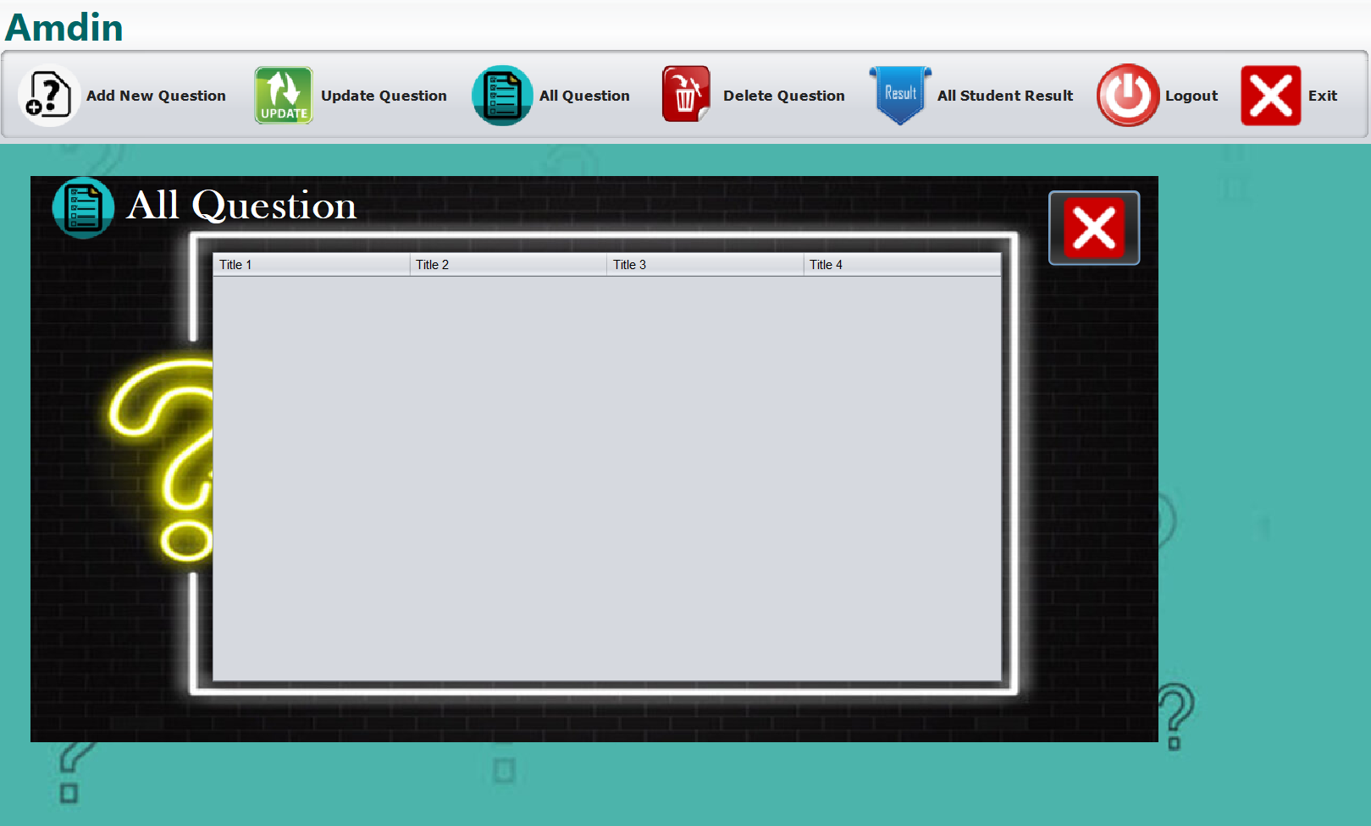

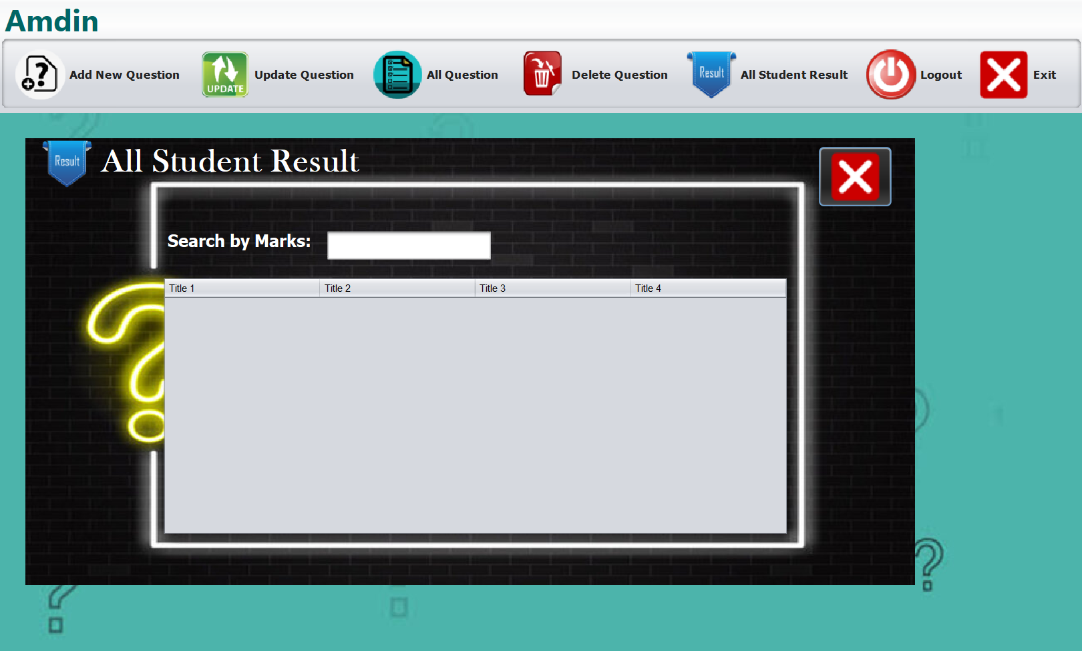
Teacher
Portal

Slide 6
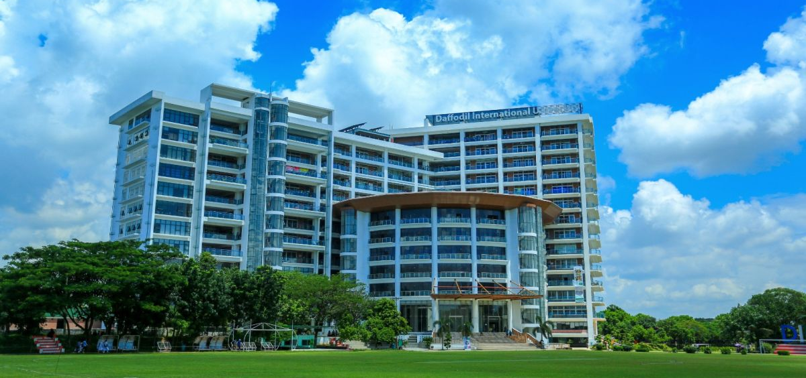


Application
Corporate Training and Development
Educational Institutions
Certification Programs

Slide 7


